Slide 1

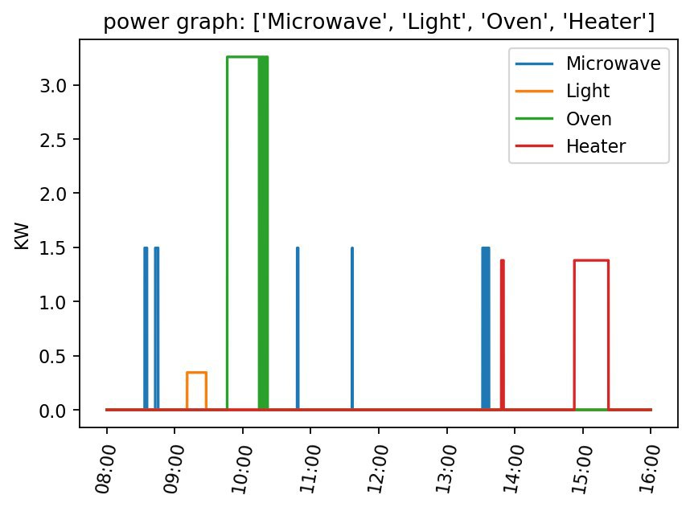
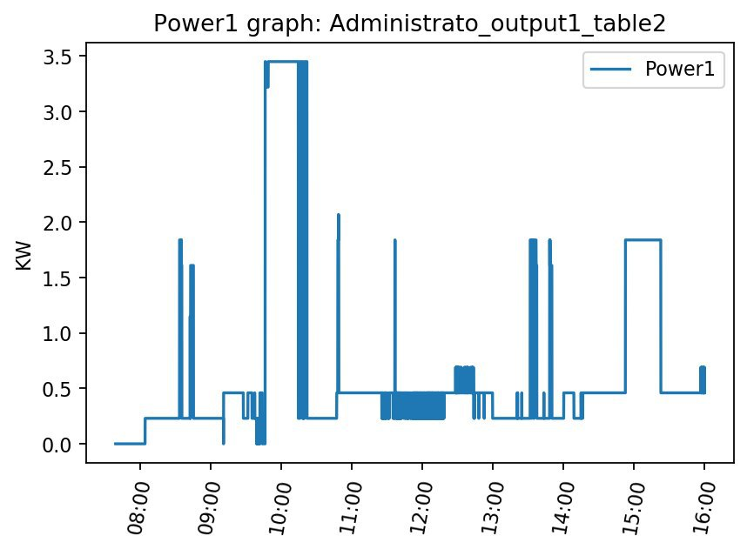

NILM in Smart Grids
Project Number: 19-1-1-1950
Names: Matan Matzliach and Alon Satchi
Advisor: Dr. Yuval Beck
Introduction PAY ATTENTION, this template may seem overloaded with text, this is only due to specifying the guidelines for creating the poster. Your poster should have only brief sentences and not too overloaded with text, such that, one will be able to read and understand your poster within 5 minutes. Including images, graphs, tables, plots, block diagrams is highly recommended. You may edit this section with the project details, plots, tables and images. THE ENTIRE POSTER IS IN ENGLISH ONLY. The recommendation is to use 2-3 columns for the entire poster. You may change this 3 column structure to another structure if it helps present your project. Pay attention to the font Calibri) and the font size. All the suggested topics (Introduction, Motivation, Methods, Results, Conclusions, Bibliography) are only a recommendation and may be changed according to your project. Pay attention that your poster should be editable including all text editable. You may change the color and image of the background. You may change the color of the text, make sure it is readable. The poster size is set to height 70cm, width 100cm (landscape), DO NOT CHANGE THAT. Do not change the location of the symbols, logos, and the project title (with the number and names) Motivation/Objectives If you use the “motivation/objectives” topic, please omit the undesired title for this topic – for example, use just Objectives as the title for this topic. Here we can also see an example, that even though the column text space ends here, we may still continue elaborating on this | topic immediately in the next column. Methods/Implementation Here we can see an example of text followed by an example block diagram that helps in presenting the project implementation. You may also include formulas, images, designs etc.. Make sure those are readable and with reasonable font sizes. Results Here we can see an example of text that can elaborate on the results followed by an example plots that helps in presenting the project results. You may also include graphs, plots, images, tables etc.. | ssaa Bibliography You may edit this section with relevant citations for the poster Pay attention that this section should only include the citations relevant to the poster and not for the entire project. If there are no relevant citations for the poster, the bibliography may be omitted from the poster. [1] A. M. Bronstein, M. M. Bronstein, and R. Kimmel. "Numerical geometry of non-rigid shapes”, Springer-Verlag New York Inc, 2008. [2] G. B. Giannakis , "Highlights of Signal Processing for Communications", IEEE Signal Processing Magazine, Vol. 16, no 2, pp. 14-49, March 1999 [3] G. Welch and G. Bishop – "An Introduction to the Kalman Filter", http://www.cs.unc.edu/~welch/kalman/kalman_filter/kalman.html#pgfId-11854
Initial
Conditions
Strapdown
Solution
Kalman
Filter
GPS
IMU
Integrated
Solution

